Slide 1
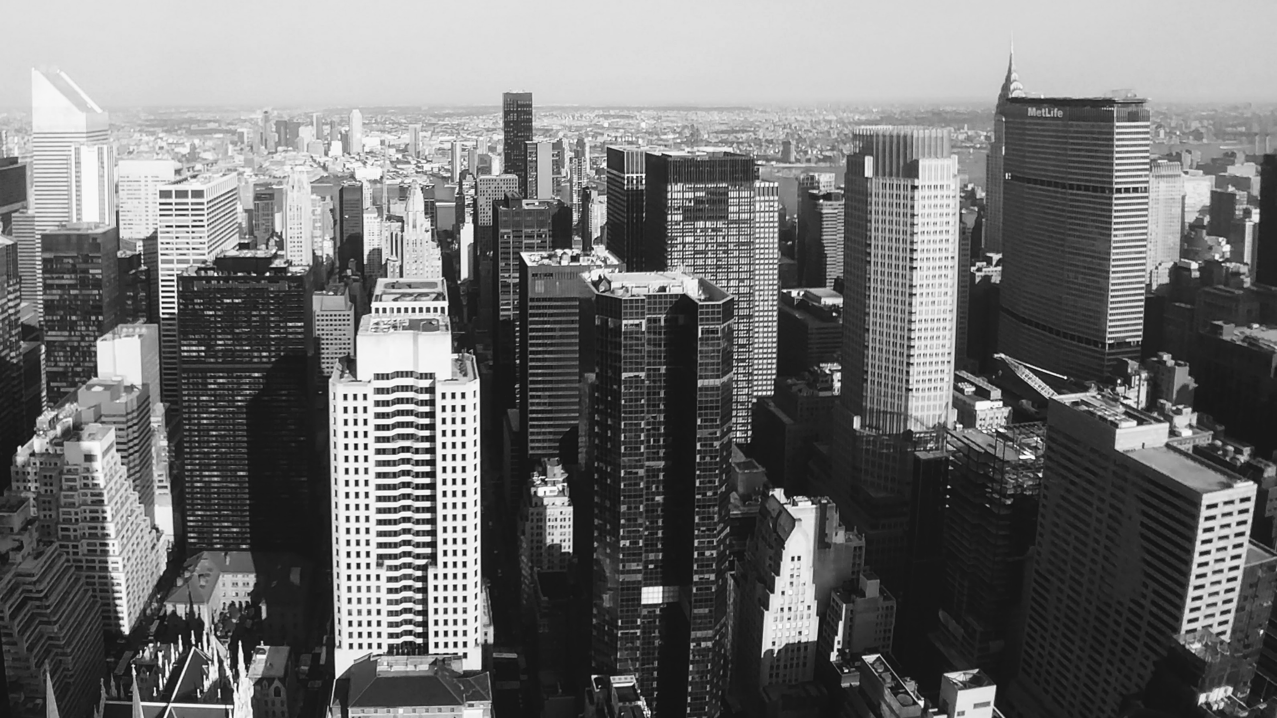
Slide 1
Opening an English Restaurant in London Area - Analysis
Capstone Project

Slide 2
Problem Statement
When it comes to restaurants London is one of the most attractive and competitive place for restaurants. With high population (9 Mil) and large numbers of tourists (30 Mil per year), the capital of England host approximately 18,000 restaurants. Considering the high cost of opening a restaurant (500-1,000K$ the need of having some data driven decision seems imperial. The location of the restaurant will impact the success rate along with the cost allocated. For this we will try to identify the best location to open an English restaurant by trying to segment the London areas and see if there are some similitudes between them. Once they are identified we can start identifying the best cohort and choosing the optimal location where a restaurant will work.

Slide 3
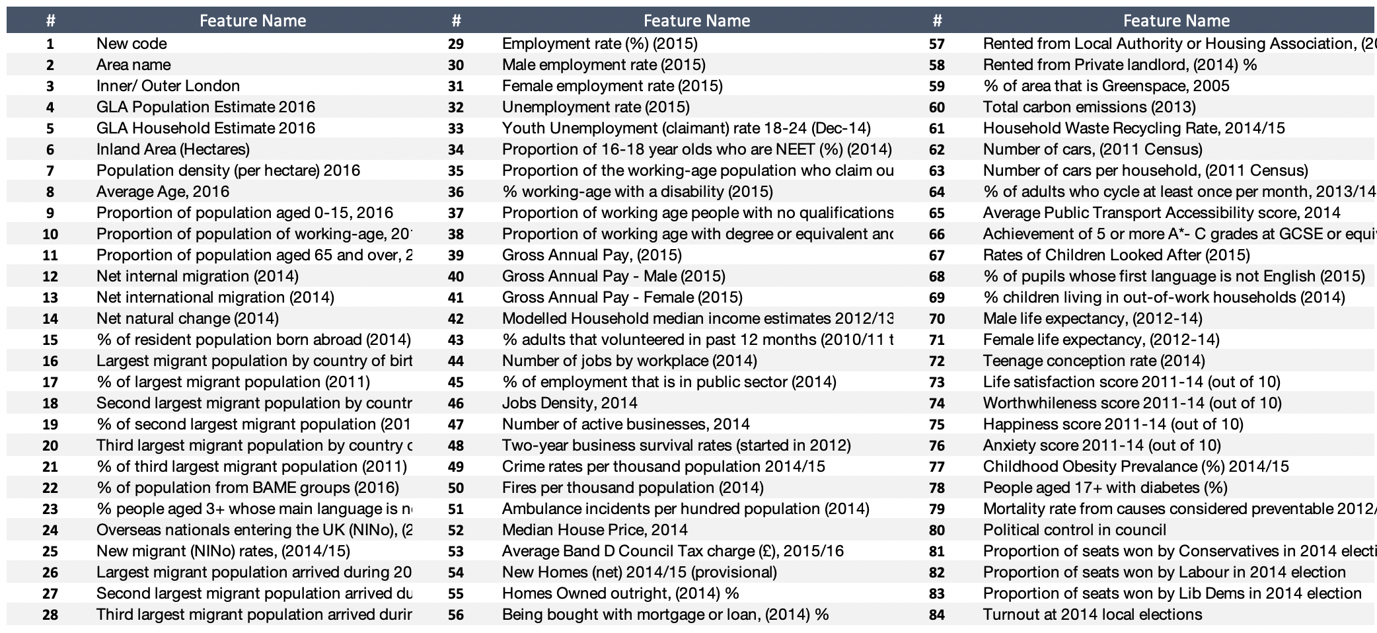
Slide 10
DATA Collection
The data was selected Kaggle raw data containing info related each area and can be seen in the Table on the right
The data was enhanced with venues information collected via Foursquare API
Your logo
10

Slide 4
Slide 10
DATA
Cleaning
The data was clean by changing the formats of the features and eliminating the unnecessary symbols used like (commas or pound sign )
Some features – that are unnecessarily for restaurants analysis were dropped
Data related restaurant category, restaurant location were added to the data set.
Restaurants ranking collection was unsuccessful both via API and via web scrapping techniques
Feature selection was done in several ways
Features intercorrelation. Features that had two higher correlation between them were eliminated as duplicated
Features correlated with number of restaurants were grouped and used in a separate classification
Trial and error, with multiple scenarios. The most relevant scenarios and results are showed in the next slide
Your logo
10

Slide 5
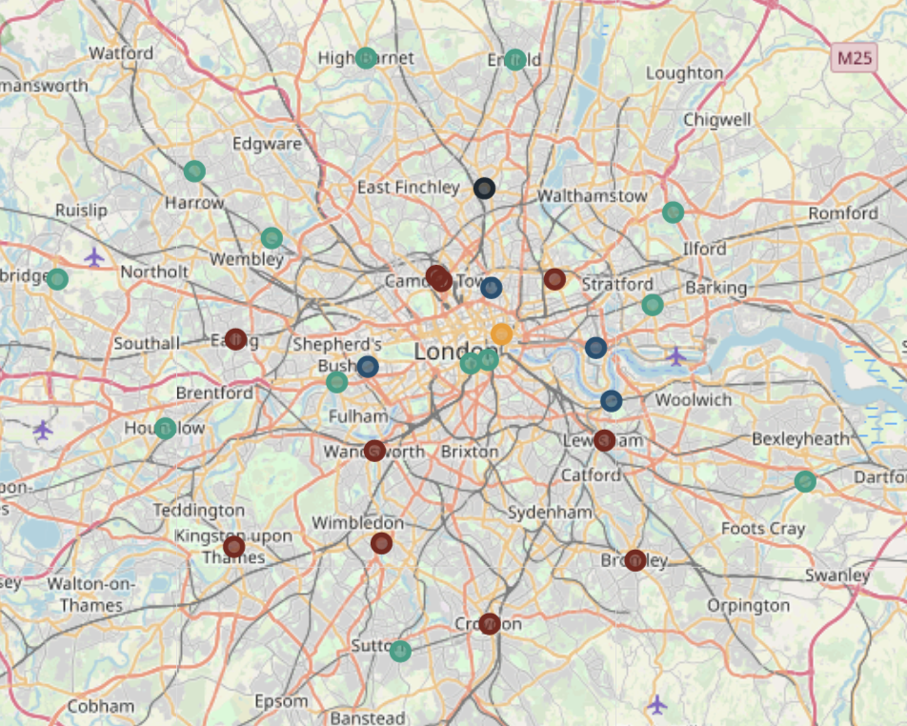
Slide 10
Methodology
The ML algorithm selected was K-MEAN due to its suitability for our set of data
The end goal was to define a set of clusters that can be used as support for future data analysis that will allow a recommendation for the best area of investment
Your logo
10

Slide 6
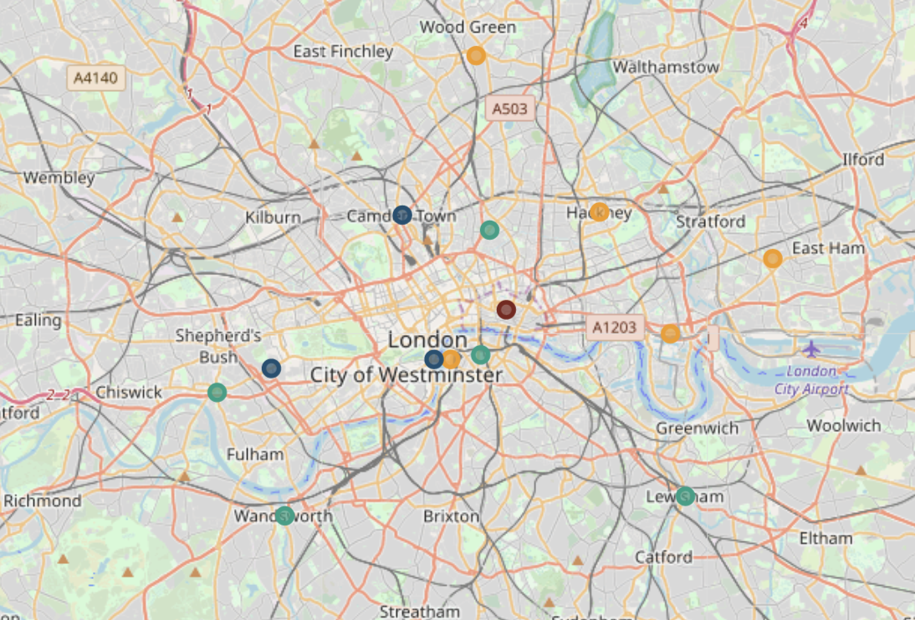
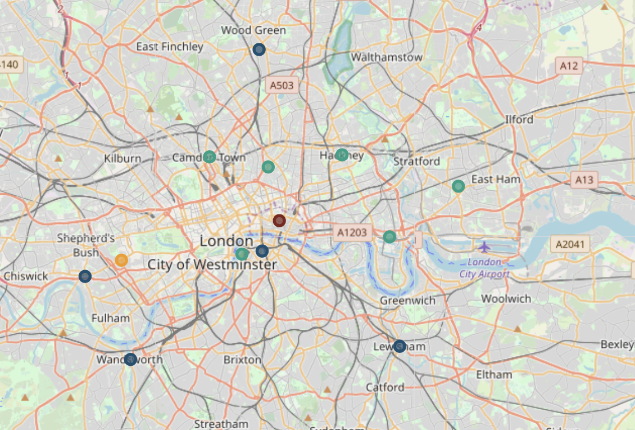
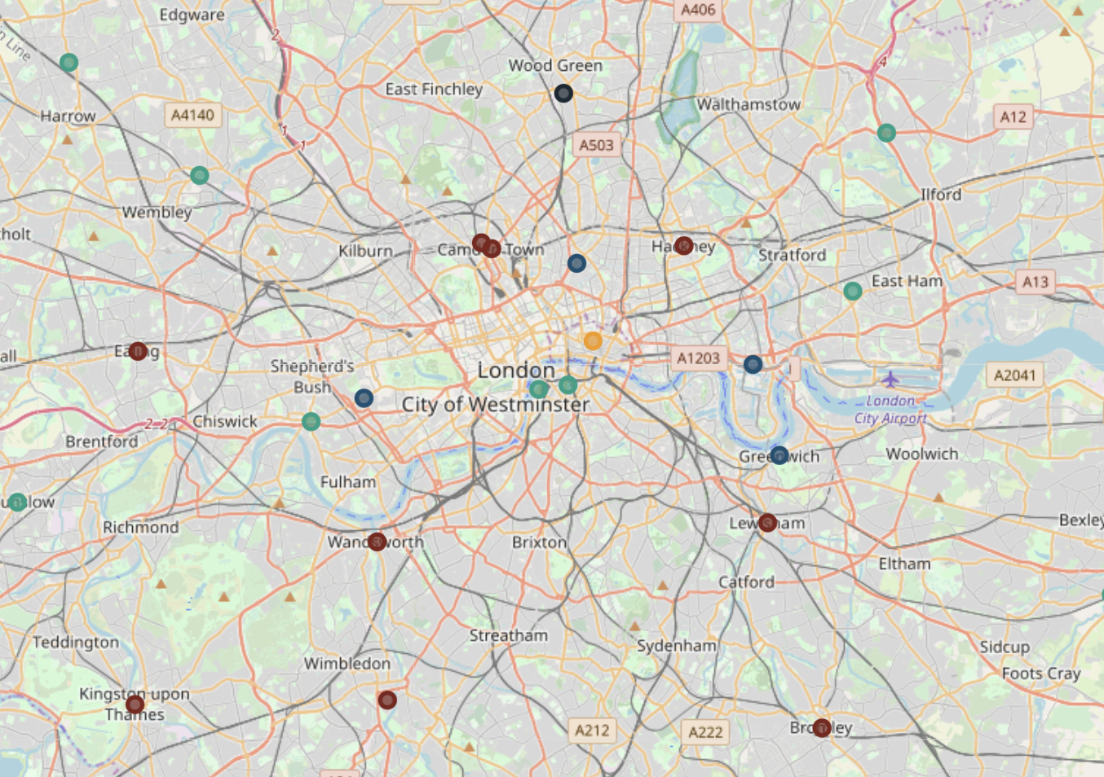
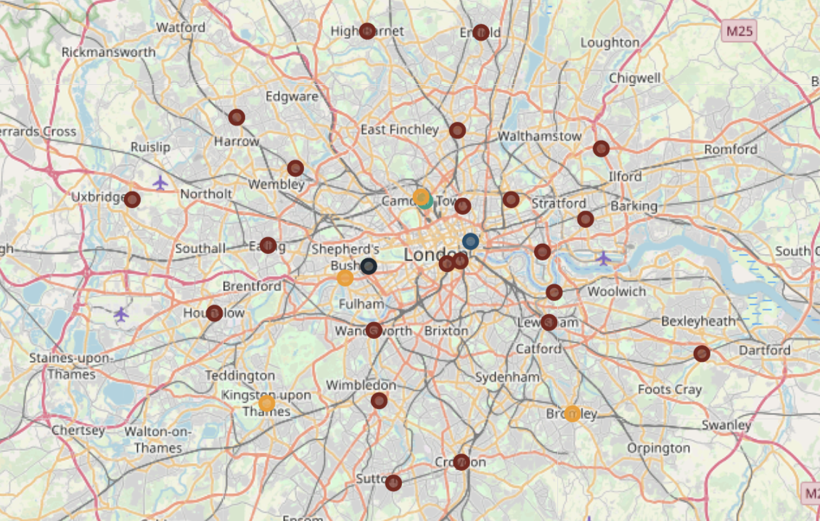
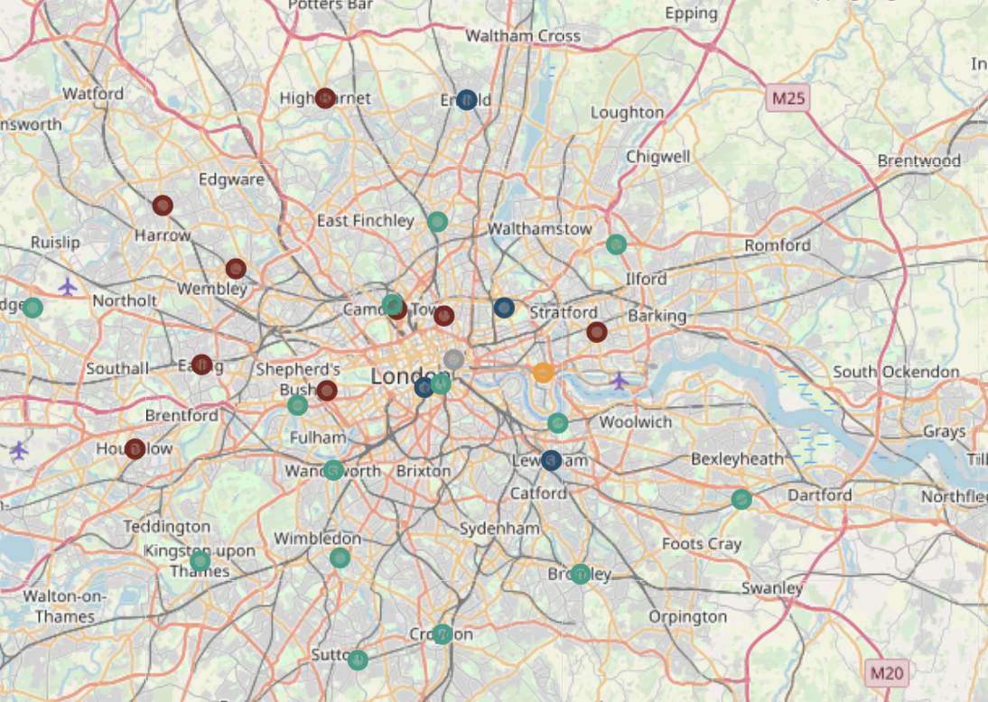
Slide 10
Results
❌
❌
❌
Top 6 scenarios resulted based on different features selected are displayed on the right
The details of features selected are described in the report
✅
❌
❌
Your logo
10

Slide 7
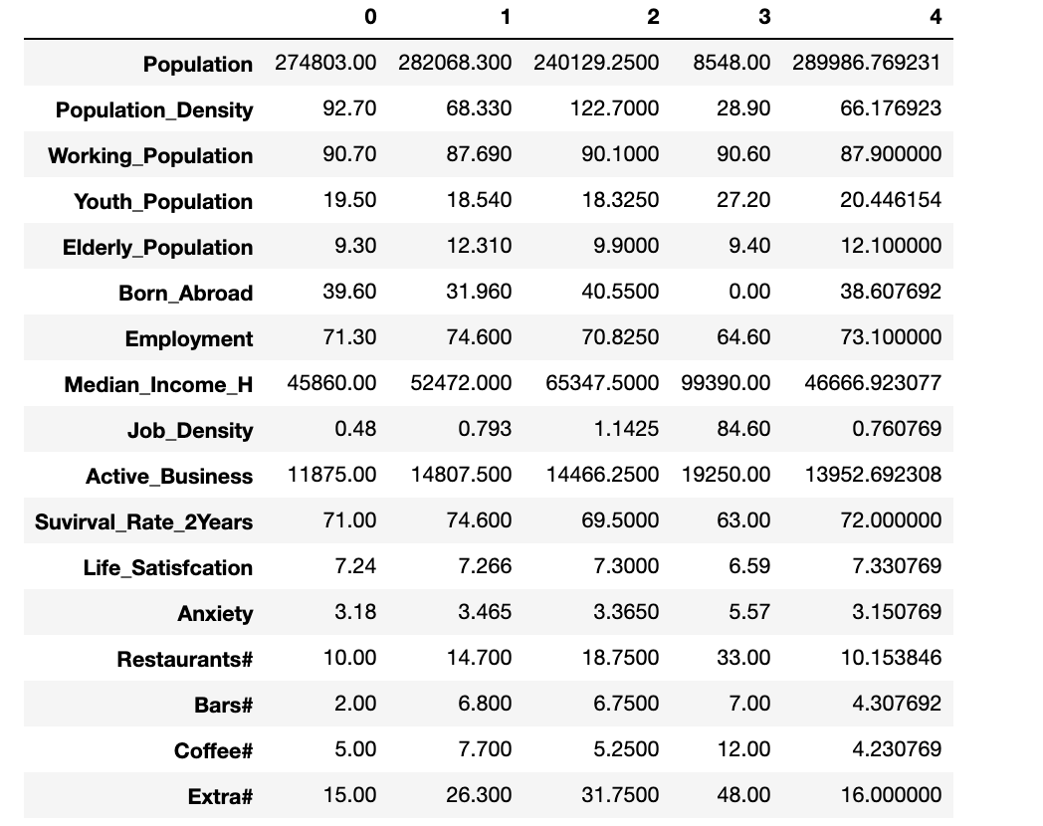
Slide 10
Results
Additional Results are the group of top 10 venues, restaurants category for each area, along with the most preeminent migrants category (Migrants were not used the final conclusions)
Top factors based segmented based on resulted clusters (Table on the right)
Your logo

Slide 8
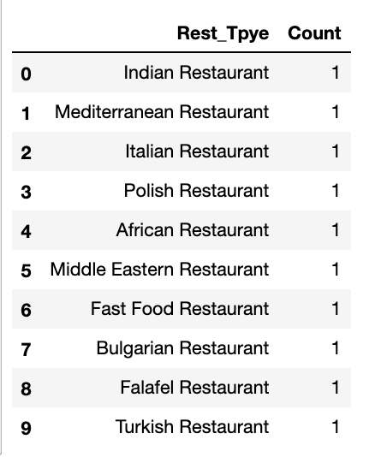
Slide 10
Results Clusters 0
Areas covered: Haringey
Properties:
Low on restaurants
Relative high population density but low job density
Lower household income
Conclusion
Not recemented to invest in restaurants in this area, seems more like an industrial area or a quiet residential area
Does not seem the most attractive area for restaurant’s landscape
Your logo

Slide 9
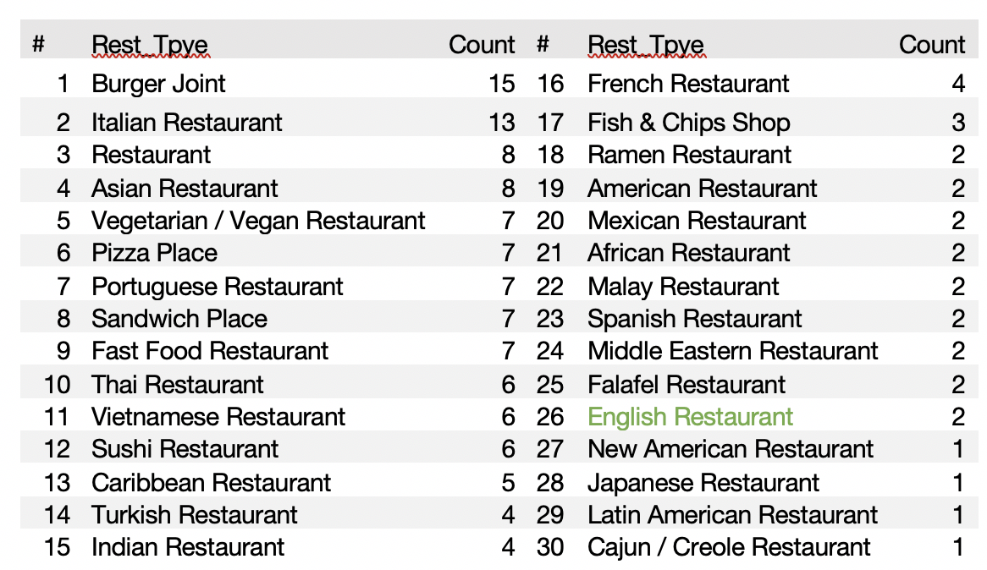
Slide 10
Results Clusters 1
Areas covered:
Bromley, Camden,Croydon, Ealing, Hackney, Havering, Kingston upon Thames, Lewisham, Merton, Wandsworth
Properties:
o Relative low density
o Relative higher elderly population
o High employment rate
o Better than cluster 1 median earnings
o Highest business success rate
o Decent number of restaurants
Conclusion
o Seems to be a stable attractive area
o But does not seem to be an attractive/successful place for English restaurants
Your logo

Slide 10
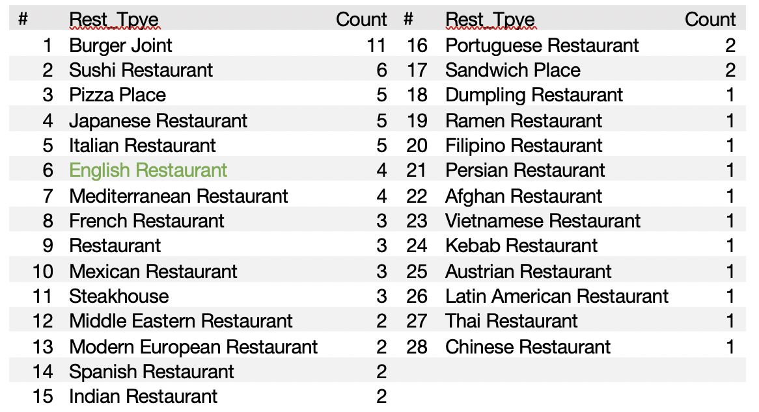
Slide 10
Results Clusters 2
Areas covered: 'Greenwich', 'Islington', 'Kensington and Chelsea', 'Tower Hamlets'
Properties:
Highest density populated of all districts
Highest diversity
Highest job density
Lower elderly population suggesting a more dynamic and crowded area
Lower survival rate suggesting a competitive landscape
Considerable number of restaurants
More interest shown for English restaurants
Second highest income area
Conclusion
Seems to be an attractive area with good dynamics
Seems to be the best place for a English restaurant

Slide 11
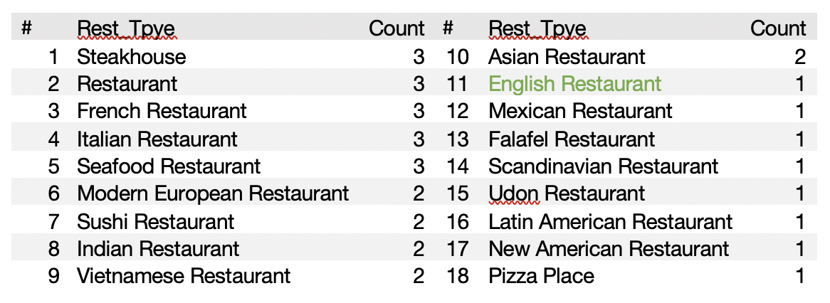
Slide 10
Results Clusters 3
Areas covered: City of London
Properties:
Low density suggesting a relative expensive area with limited housing
Covers only the city center of London and seems to be the most peculiar cluster
Low employment rate
Lower elderly population suggesting a more dynamic and crowded area
Very high job density
Competitive business landscape with the lowest success rate of business
High bars and restaurants density suggesting a very promising area
High “Extra” attraction suggest a very tourist area
By far the highest median income area
Conclusion
Probably the most attractive area to invest with high potential but a risky one non the less.
Expected to have high competition, cost of operation and initial cost
English restaurants seems not be very prominent, but nevertheless a good restaurant in this area can be very successful

Slide 12
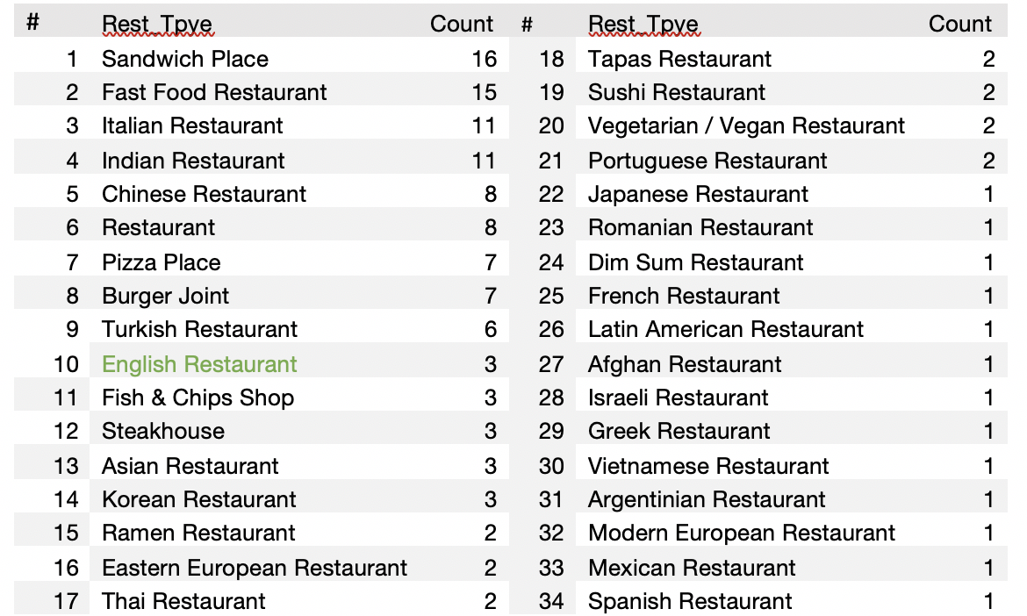
Slide 10
Results Clusters 4
Areas covered: Barnet, Bexley, Brent, Enfield, Hammersmith and Fulham,Harrow, Hillingdon, Hounslow, Lambeth, Newham,Redbridge, Southwark, Sutton
Properties
Median population density with a relative lower number of available restaurants
Relative low median income and lower job density than the rest of clusters
Fairly stable business continuity
Conclusion
Can be an interesting opportunity for investment for a small restaurant with no high income expectations
Overall not the most attractive cluster to invest

Slide 13
Slide 10
Conclusions
There seems to be a lack of English restaurants resulting from the data collected using Foursquare, placing the English restaurants category outside of top ten categories after Italian, Burgers joins, Asian restaurants, Indian Restaurants and others
Surprisingly, the number of French, Portuguese or Vietnamese restaurants exceeds the English ones (this might be due to the limited data collection), nevertheless the 1400+ venues collected should be a significant sampler for making the above assumptions
Multiple analysis scenarios were performed where different features were selected, and the results are presented in the table xx above. Out of these scenarios one that seems to have the better cluster distribution was selected. Scenario 4 was selected
The analysis concluded above allow us to segregate the London restaurants landscape into 5 clusters based on restaurants types and numbers and the data was completed with other significant information like: population density, job density, household income, working population, business survival rate, life satisfaction, anxiety and coffee shops and bars numbers

Slide 14
Slide 10
Conclusions
Thought the analysis the City of London itself was always placed in a separate individual cluster making us realize the uniqueness of this area
However the most promising scenario are Clusters 2 ('Greenwich', 'Islington', 'Kensington and Chelsea', 'Tower Hamlets') and Cluster 3 (City of London) showing high potential for new restaurants. Out of these two scenario the safest bet seems to be on Cluster 2 because it seems less riskier and challenging than Cluster 3. See detailed analysis and conclusions on the above chapters

Slide 15
Slide 10
Future
Extending the data set that will require another level of account in Foursquare. The ability to add more data should results in better results
Add ranking for restaurants. The current analysis was performed without ranking due to limitations:
imposed by the Foursquare account (providing a limited number of rankings)
Inability to use web scraping techniques due to protection from Foursquare
Changing the account type should allow the collection of rating, but it comes with additional costs
The current analysis concluded that Cluster 2 is the best candidate, however the investigation can continue inside Cluster 2. The same type of analysis can be performed in order to detect which particular section of this Cluster is most suited for opening a restaurant. Adding cost of rent in the equation might also increase the output of the analysis

Slide 16

Slide 11
THANK YOU

